Slide 1

INTRODUCING SUPERCYCLE® ETFS
NYSE:VistaShares Electrification Supercycle® ETF (POW)

Slide 2


Platform
Introduction
SUPERCYCLE® ETFS PROVIDE PURE EXPOSURE TO THE DISRUPTIVE TRENDS SHAPING THE NEXT TWO DECADE
2

Slide 3





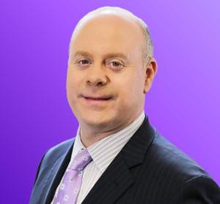

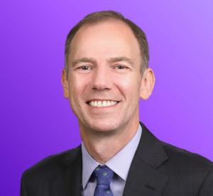



Expert Product Stewardship
VistaShares leverages expertise in portfolio construction, investment management and critically, the deep knowledge of industry executives relevant to individual supercycles.
Platform
Investment Committee
Adam Patti
Chief Executive Officer Former Founder/CEO IndexIQ Former Head of Global ETFs NY Life
Jon McNeill
Co-Founder
CEO DVx Ventures
Board Member General Motors Former President Tesla Former COO Lyft
Robert Whitelaw Chief Investment Strategist Former Dean NYU Stern School of Business
Chairman of Finance Dept NYU Stern School of Business
Sunny Madra Advisor to Investment Committee
President, Groq
Justin Lopas Advisor to Investment Committee
Co-founder, COO, Base Power

Slide 4









Team
Platform
Team
Adam Patti
VistaShares CEO
Jon McNeill
VistaShares Co-founder
Robert Whitelaw
VistaShares
Chief Investment Strategist
Chris Hutton
VistaShares CFO
Mike
Williamson
VistaShares
SVP, Sales & Marketing
David Fetherstonhaugh
VistaShares
SVP, Investment Strategist
Sunny Madra
VistaShares
Advisor to Investment Committee
Justin
Lopas
VistaShares
Advisor to Investment Committee

Slide 5
GAIN EXPOSURE TO THE ELECTRIFICATION SUPERCYCLE®
Platform
Introduction
5

Slide 6
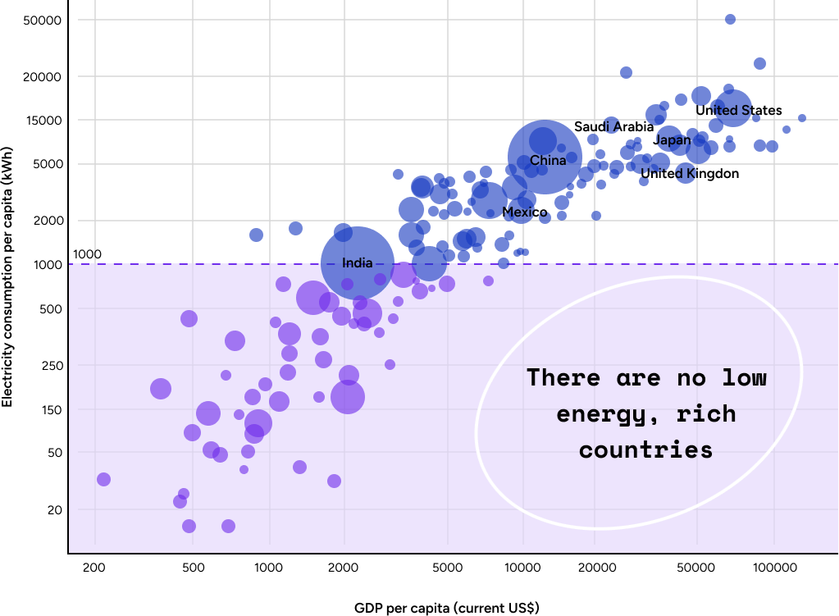
Energy is the driving force of GDP & Economies
Electrification
Investment Case
AI marks a seismic shift in how humans interact with technology — but its foundation is power. No country has ever grown rich without abundant energy, and the data proves it: there are no low-energy, rich nations.
As AI adoption accelerates, electricity becomes the new limiting factor. Every model, data center, and chip adds pressure to the grid. The AI boom is, at its core, an energy supercycle — linking intelligence, infrastructure, and prosperity.
Source: US Energy Information Administration, World Bank
(2021) R²=0.8

Slide 7
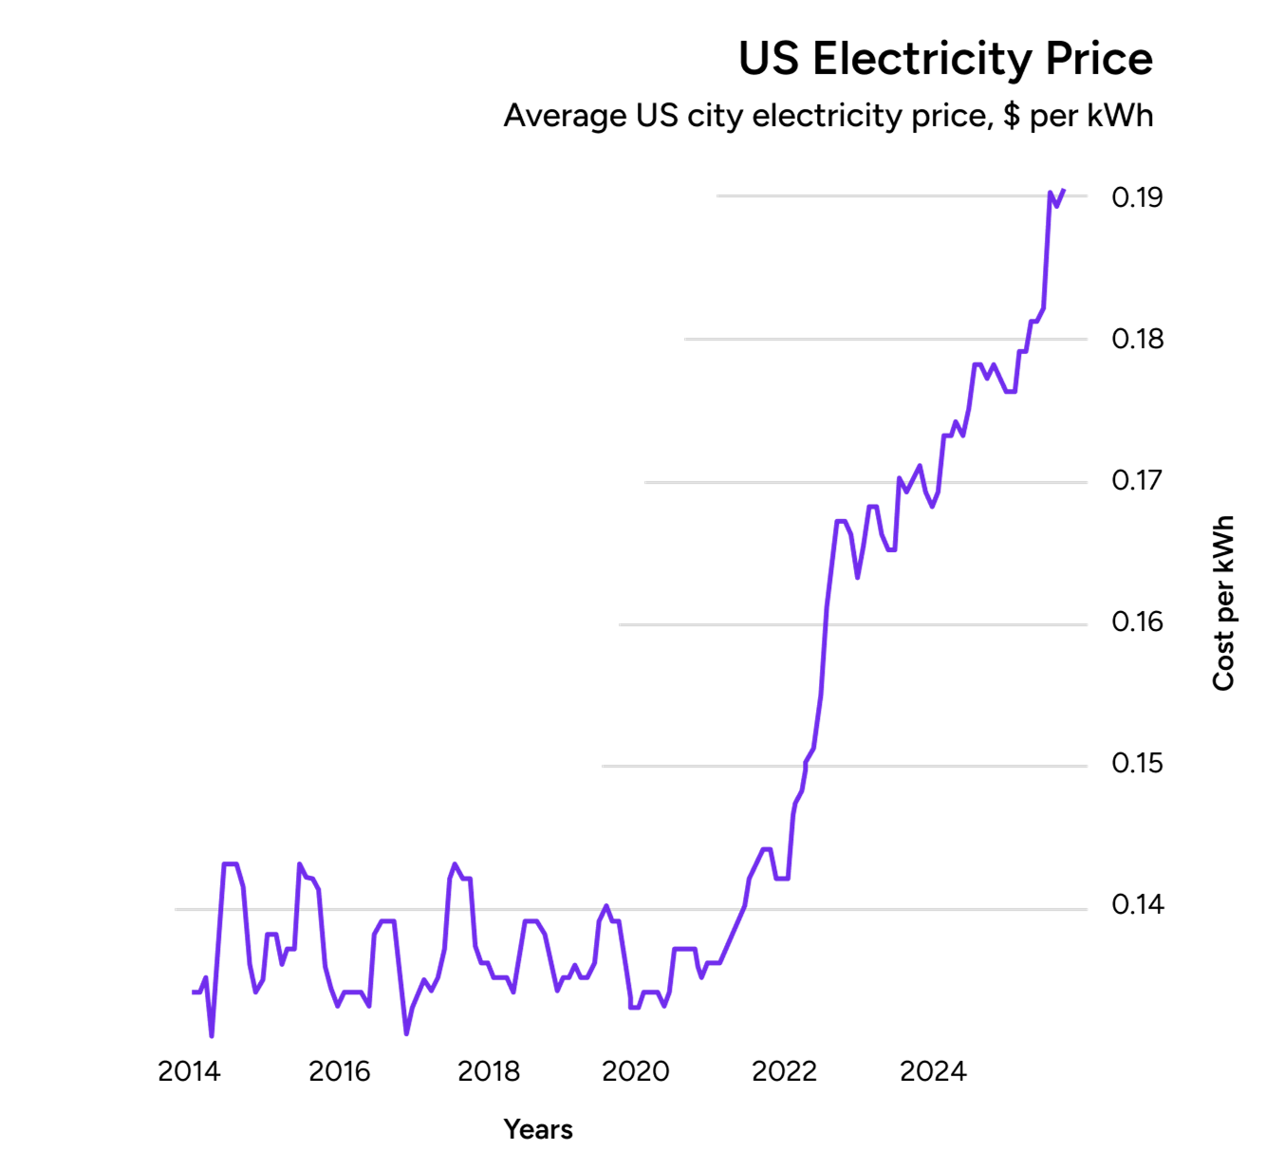
Electrification
Investment Case
US electricity prices are already under pressure
Cheap, and abundant energy; the driving force of a productive economy is starting to show very early cracks. There needs to be heavy investment in the US infrastructure to reverse this trend, and capture the related productivity gains
Soure: Brian Potter, FRED

Slide 8
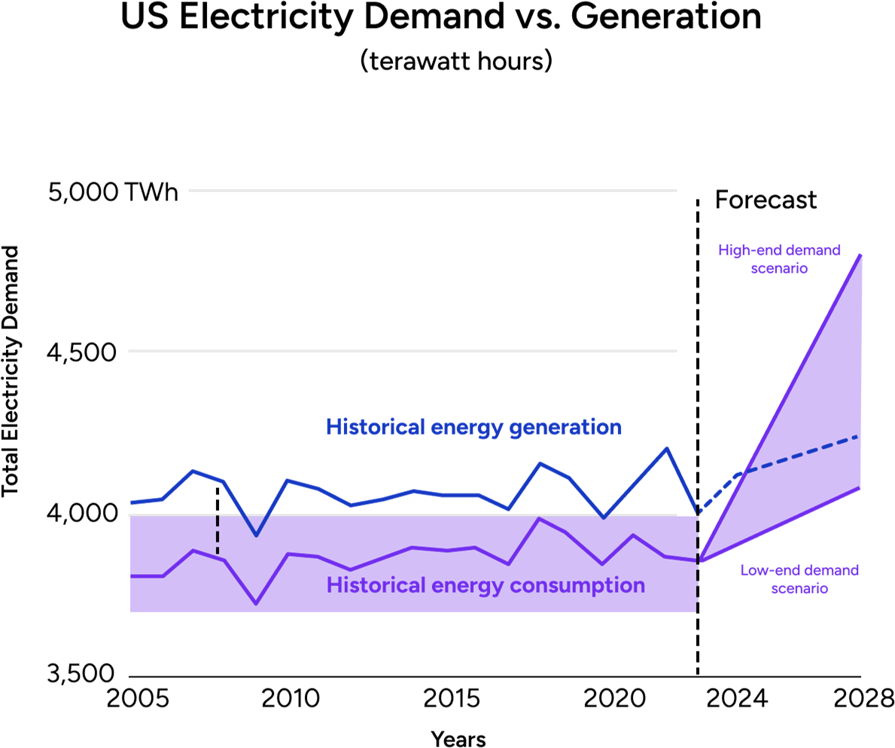
Demand is set to skyrocket
Electrification
Investment Case
Generation demands are increasing, driven by the need for ever increasing amounts of compute and infrastructure for new technologies
Notes: Demand forecast is an aggregate of multiple industry forecasts; historical numbers and generation forecast based on EIA data; historical gap between energy generation and consumption necessary to ensure sufficient load that accounts for some energy loss in transmission
Sources: EIA 2023–2025 Short-Term Energy Outlook (May 2024); EIA 2025–2028 Energy Outlook (March 2023); ISO reports (H2 2023 – H1 2024); FERC; Grid
Strategies; Goldman Sachs and Bank of America analyst forecasts (April 2024); Bairn analysis

Slide 9
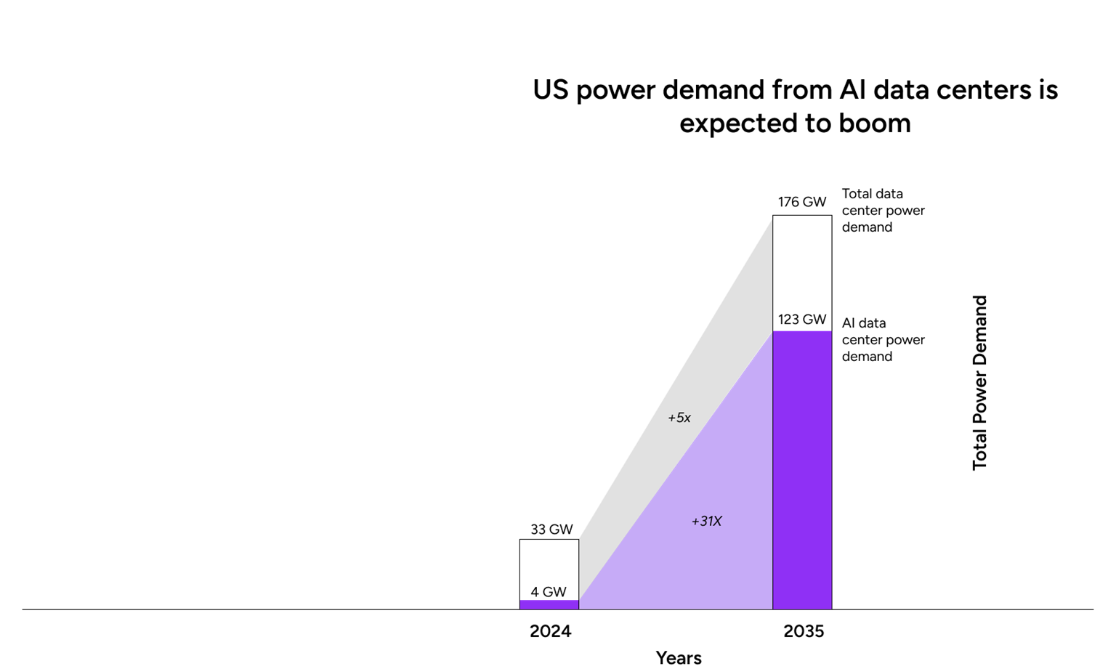
AI Supercycle a major Catalyst
Electrification
Investment Case
AI & data centers represent a core driver of this need for increased generation, and more importantly, improved power distribution and transmission
Data Center power demand is set to increase 5x by 2035
Source: Deloitte analysis of data from DC Byte, Wood Mackenzie, S&P Global, Lawrence Berkeley National Laboratory, and Wells Fargo.

Slide 10
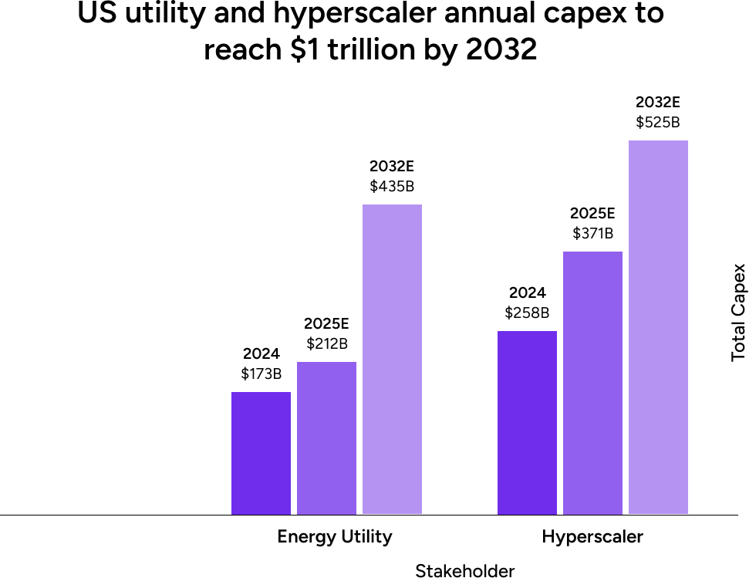
Trillions in Capex over the next 5 years
Electrification
Investment Case
Trillions in Capex is being deployed to enable the ecosystem to capitalize on AI, and all the unlocks the technology provides.
The energy grid alone is set to absorb multi-trillion dollars in investment opportunities across generation, transmission, distribution, and all the related underlying components that are vital to the resilience and efficiency of the grid.
Source: Deloitte analysis of data from DC Byte, Wood Mackenzie, S&P Global, Lawrence Berkeley National Laboratory, and Wells Fargo.

Slide 11
VistaShares Electrification
Supercycle® ETF (POW)
Electrification
Investment Case
LOOKS DEEPER
11

Slide 12
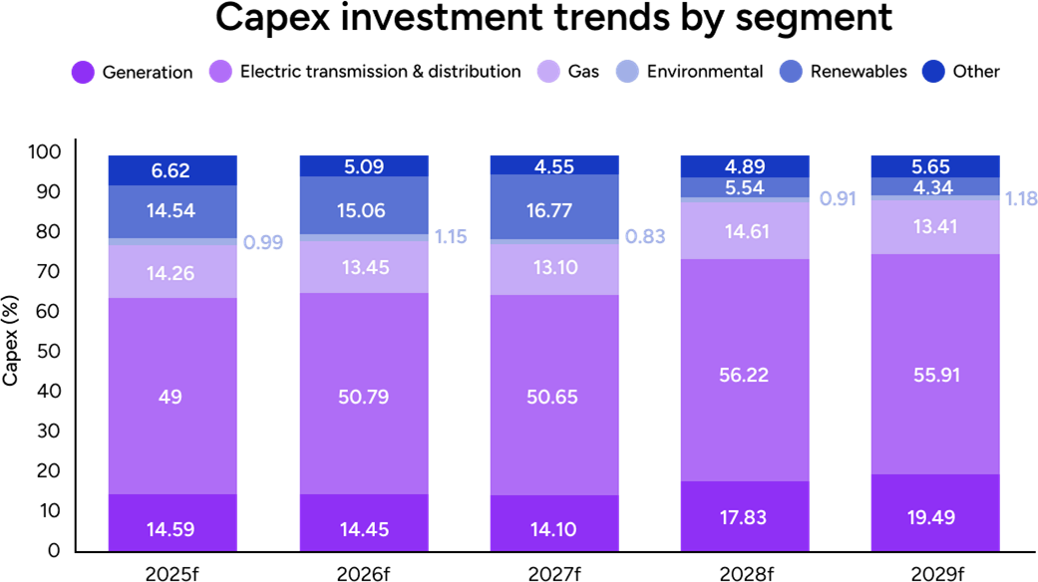
The US doesn't have an Energy problem. It has a Power problem.
Electrification
Investment Case
We’ve built 1.3 TW of generation capacity, yet peak load barely cracks 750 GW. This may be an oversimplification, but we believe the issue isn’t supply, it’s getting power to load, when and where it’s needed.
55% of total electricity system spend goes toward moving power, not making it. We call that a Power Problem.
Compiled March 24, 2025. capex = capital expenditure; distr. = distribution; trans. = transmission; f = forecast. Gas includes pipeline, storage, distribution and other gas infrastructure. Source: Regulatory Research Associates, a group within S&P Global Commodity Insights. © 2025 S&P Global.

Slide 13
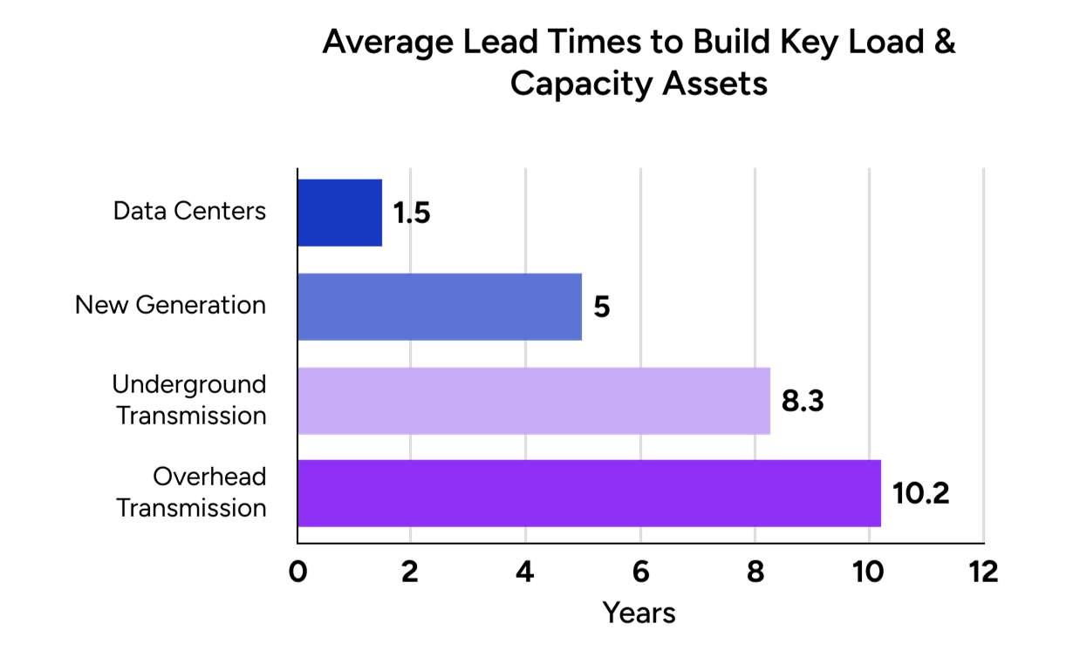
Electrification
Investment Case
The bottleneck to the AI Supercycle is not only Data Centers, it’s Power.
Source: IEA, Average lead times to build new electricity grid assets in Europe and the United States, 2010–2021, IEA, Paris https://www.iea.org/data-and-statistics/charts/average-lead-times-to-build-new-electricity-grid-assets-in-europe-and-the-united-states-2010–2021
, IEA. Licence: CC BY 4.0.
Rand, Joseph, et al. “Queued Up: Characteristics of Power Plans Seeking Transmission Interconnection as of the End of 2022.” Lawrence Berkeley National Laboratory, Apr. 2023.

Slide 14
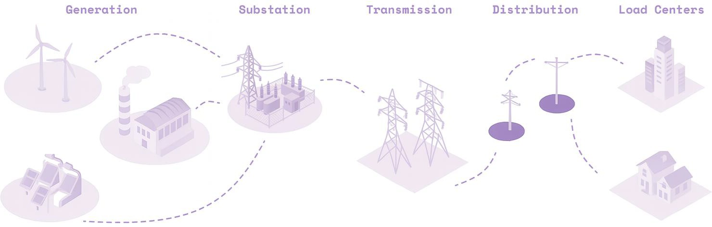
System Under Strain: Constraints across every layer
Electrification
Investment Case
US grid interconnection costs have risen by 4x and lead-times have risen by 2x over the past 15–20 years.
Lead times to connect new data centers and EV chargers into the grid have blown out to 3–5 years.
6x more wind/solar projects are installing 2x larger batteries upstream of substations to avoid network upgrades.
Lead-times have blown out to 12–60 months for transformers, switchgear, and other equipment.
Wind/solar curtailment rates have risen by 8x to 5% globally due to T&D bottlenecks.
A large new T&D line may need to obtain as many as 13,500 permits, and delayed projects take 15–20 years.
US end consumer outages have risen by 2x over the past decade, mostly due to grid overloads.
Source: https://thundersaidenergy.com/2024/03/07/power-grids-the-biggest-bottleneck-in-the-world/

Slide 15

POW IS AN
Electrification
Product Overview
ELECTRIFICATION SUPERCYCLE® ETF TARGETING THE PROFIT POOLS THAT MATTER
15

Slide 16




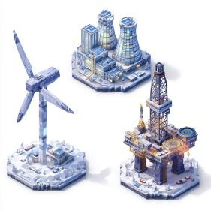
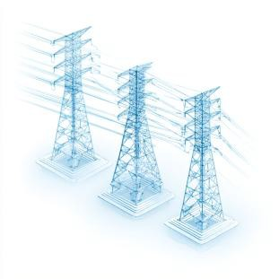
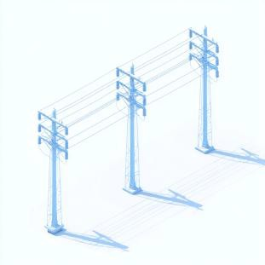
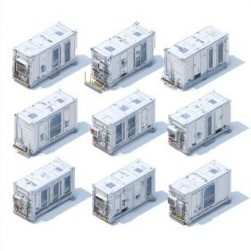
We invest where the current flows
Platform
Product Overview
1 Generation 2 Transmission 3 Distribution 4 Storage
Power generation including Hydrocarbons, renewables, nuclear etc. We’ve included operators in our initial ETF index, and may adjust over time to lean into CAPEX cycles
Steel towers or poles, aluminum-steel conductors with optical ground wire, HVDC, insulators and hardware, high-voltage transformers, breakers and busbars in substations, voltage control devices, protection/SCADA systems
Wood, steel, or concrete poles with medium-voltage conductors, pole-top or pad-mount transformers, reclosers, fuses and regulators, capacitor banks, smart meters and sensors, connectors and enclosures
Lithium-ion cells (cathodes, anodes, separators) assembled into modules racks, battery mgmt systems, placed in steel container enclosures with HVAC, and integrated with inverters, transformers, cabling, and control software for grid connection
Source DVx Ventures Analysis

Slide 17


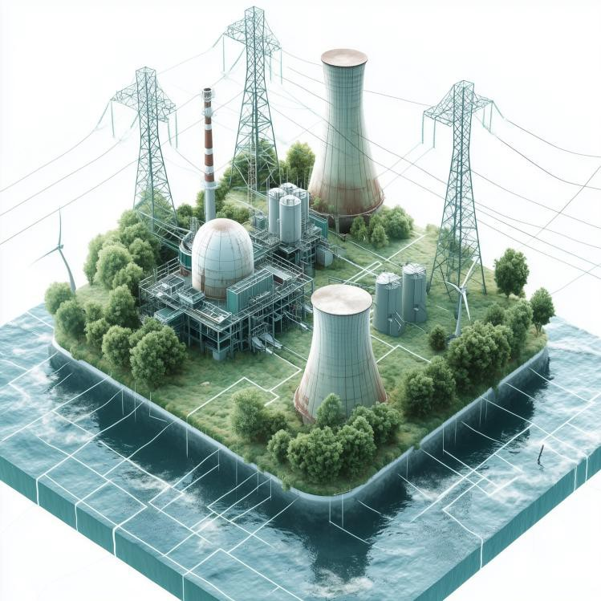






Platform
Product Overview
NYSE:POW VistaShares Electrification Supercycle ETF provides exposure to what’s
powering the future
Electrification Supercycle®
We've developed an index that tracks the profit pools within the Energy Grid supply chain. Our goal is to give investors access to the companies
Product
Transformers
Company
Eaton Corporation
Weight
4.77%
that are driving and supplying the Electrification Supercycle , not just the finished products
Product
Wiring & Fiber
Company Weight
Prysmian S P A 5.71%
Top 10 Holdings
HUBBELL INC
Weight
5.30%
DELTA ELECTRONICS THAI-FORGN EATON CORP PLC | 5.00% 4.80% | Product
GE VERNOVA INC | 4.60% | Company | Weight
POWELL INDUSTRIES INC | 4.20% | GE Vernova | 4.91%
QUANTA SERVICES INC | 4.10%
LS ELECTRIC CO LTD | 4.00%
PRYSMIAN SPA-UNSPONSOREE ADR | 3.90%
Gas Turbines
HYOSUNG HEAVY INDUSTRIES COR CONSTELLATION ENERGY
3.80%
3.80%
Product
EPC (+towers, lines)
Company Weight
Quanta Services 5.09%
Product
High Vol. Switchgear
Company Weight
Siemens Energy 6.04%
As of 10.15.2025 Holdings are subject to change.
*Graphic and weights for illustrative purposes only. Created with Mid Journey.

Slide 18





Watt We’re Made Of
Platform
Product Overview
1 Differentiated
Exposure vs. Comps
2 Actively Managed
3 Operator Led with
World Class Experts
4 Early Innings
1
“Bill of Materials” overlay weights the sub-sectors and related companies based on contribution to each step of the production process leading to a final consumer product
Index, rule based approach coupled with actively managed overlay provides ultimate flexibility to ride the innovation wave
Investment Committee monitors all companies within the various industry segments along the supply chain, actively adding or deleting companies from the index between rebalance dates, if necessary
We are still so early… Energy has remained relatively flat in the US for much of the last decade, but demand in the U.S. is expected to increase by 25% by 2030, and by a dramatic 78% by 2050, far eclipsing past trends… we are just getting started
¹ Source: https://www.icf.com/insights/energy/electricity-demand-expected-to-grow?utm_source=chatgpt.com

Slide 19
Investors should consider the investment objectives, risks, charges and expenses carefully before investing. For a prospectus or summary prospectus with this and other information about the Fund, please call (844) 875-2288 or visit www.VistaShares.com. Read the prospectus or summary prospectus carefully before investing.
Investments involve risk, including the loss of principal.
VistaShares Electrification Supercycle® ETF (POW) Risks:
Equity Market Risk: Common stocks are generally exposed to greater risk than other types of securities, such as preferred stock and debt obligations, because common stockholders generally have inferior rights to receive payment from specific issuers.
Electric Vehicle Industry Risk: Companies in the electric vehicle (EV) industry are dependent upon consumer demand for electric vehicles in an automotive sector that is generally competitive, cyclical, and volatile. If the market for electric vehicles does not develop as expected, develops more slowly, or if demand decreases, the business prospects, financial condition, and operating results of companies in the EV industry may be harmed.
Electrical Grid Technologies and Energy Solutions Industry Risk: Electric grid and solutions companies are subject to numerous challenges that could significantly impact their financial performance. As the demand for efficient electricity management, renewable energy storage, and innovative power solutions grows, these companies must continuously invest in research, development, and infrastructure to stay competitive. This can lead to high capital expenditures and increased operational costs.
Consumer Discretionary Sector Risk: The success of consumer product manufacturers and retailers is tied closely to the performance of the overall domestic and global economy, interest rates, competition and consumer confidence. Success depends heavily on disposable household income and consumer spending.
Foreign Securities Risk: Investments in securities or other instruments of non-U.S. issuers involve certain risks not involved in domestic investments and may experience more rapid and extreme changes in value than investments in securities of U.S. companies. Financial markets in foreign countries often are not as developed, efficient, or liquid as financial markets in the United States, and therefore, the prices of non-U.S. securities and instruments can be more volatile
Index Strategy Risk: The Fund’s strategy is linked to an Index maintained by the Index Provider that exercises complete control over the Index. The Index Provider may delay or add a rebalance date, which may adversely impact the performance of the Fund and its correlation to the Index. In addition, there is no guarantee that the methodology used by the Index Provider to identify constituents for the Index will achieve its intended result or positive performance. Errors in Index data, Index computations or the construction of the Index in accordance with its methodology may occur from time to time and may not be identified and/or corrected for a period of time or at all, which may have an adverse impact on the Fund.
New Fund Risk: The Fund is a recently organized management investment company with no operating history. As a result, prospective investors do not have an extensive track record or history on which to base
their investment decisions.
New Sub-Adviser Risk: The Sub-Adviser is a newly formed entity and has no experience with managing an exchange-traded fund, which may limit the Sub-Adviser’s effectiveness.
The Sub-Adviser defines an “AI company” as a company that, based upon publicly available revenue data derives at least 50% of their revenues from or have at least 50% of their assets invested in or have the potential to generate 50% of their revenues from or have at least 50% of their assets devoted to the production, development and/or operation of (i) high-performance semiconductors used for AI (artificial intelligence) related hardware & software, (ii) AI related datacenters, and/or (iii) AI enabled applications.
CapEx (Capital Expenditure) refers to the money a company spends to acquire, upgrade, or maintain long-term physical assets such as property, buildings, technology, or equipment.
Foreside Fund Services, LLC, distributor.

Slide 20
vistashares.com adam@vistashares.com info@vistashares.com

